Slide 1

Reinforcement Learning
Dr. Prasenjit Dey,
Assistant Professor,
NIT Rourkela,
Odisha, India

Slide 2
Previous Lectures
Supervised learning
Learning from labeled data
Tasks: classification, regression
Unsupervised learning
Learning from unlabeled data
Task: clustering
Reinforcement learning
Learning through interaction with an environment
Agent takes actions and receives rewards
Goal: maximize cumulative reward
environment
reward
new state
action
agent

Slide 3
Today
Examples of Reinforcement Learning
Formulating an RL problem
Markov Decision Processes
solving an RL problem
Dynamic Programming
Monte Carlo methods
Temporal-Difference learning
Notes:
Dynamic Programming, which assumes a complete model of the environment.” “Monte Carlo methods, which learn from complete episodes of experience.” “Temporal-Difference learning, which combines ideas from both and learns step by step.”

Slide 4
Robot in a room
 |  |  | +1
 |  |  | -1
START
actions: UP, DOWN, LEFT, RIGHT
UP
80%
10%
10%
move UP move LEFT move RIGHT
reward +1 at [4,3], -1 at [4,2]
reward -0.04 for each step
what’s the strategy to achieve max reward?
what if the actions were deterministic?

Slide 5

Other examples
pole-balancing
TD-Gammon [Gerry Tesauro]
helicopter [Andrew Ng]
no teacher who would say “good” or “bad”
is reward “10” good or bad?
rewards could be delayed
similar to control theory
more general, fewer constraints
explore the environment and learn from experience
not just blind search, try to be smart about it

Slide 6
Resource allocation in datacenters
loadbalancer
application A application B application C
A Hybrid Reinforcement Learning Approach to Autonomic Resource Allocation
Tesauro, Jong, Das, Bennani (IBM)
ICAC 2006

Slide 7
Robot in a room
 |  |  | +1
 |  |  | -1
START
actions: UP, DOWN, LEFT, RIGHT
UP
80%
10%
10%
move UP move LEFT move RIGHT
reward +1 at [4,3], -1 at [4,2] reward -0.04 for each step
states
actions
rewards
what is the solution?

Slide 8
Is this a solution?
 |  |  | +1
 |  |  | -1
only if actions deterministic
not in this case (actions are stochastic)
solution/policy
mapping from each state to an action

Slide 9
Optimal policy
 |  |  | +1
 |  |  | -1

Slide 10
Reward for each step: -2
 |  |  | +1
 |  |  | -1

Slide 11
Reward for each step: -0.1
 |  |  | +1
 |  |  | -1

Slide 12
Reward for each step: -0.04
 |  |  | +1
 |  |  | -1

Slide 13
Reward for each step: -0.01
 |  |  | +1
 |  |  | -1

Slide 14
Reward for each step: +0.01
 |  |  | +1
 |  |  | -1

Slide 15
Markov Decision Process (MDP)
set of states S, set of actions A, initial state S₀
transition model P(s,a,s’)
– P( [1,1], up, [1,2] ) = 0.8
environment
reward new state
action
reward function r(s)
– r( [4,3] ) = +1
agent
goal: maximize cumulative reward in the long run
policy: mapping from S to A
π(s) or π(s,a) (deterministic vs. stochastic)
reinforcement learning
transitions and rewards usually not available
how to change the policy based on experience
how to explore the environment

Slide 16
Computing return from rewards
episodic (vs. continuing) tasks
“game over” after N steps
optimal policy depends on N; harder to analyze
additive rewards
V(s₀, s₁, …) = r(s₀) + r(s₁) + r(s₂) + …
infinite value for continuing tasks
discounted rewards
V(s₀, s₁, …) = r(s₀) + γ*r(s₁) + γ²*r(s₂) + …
value bounded if rewards bounded

Slide 17






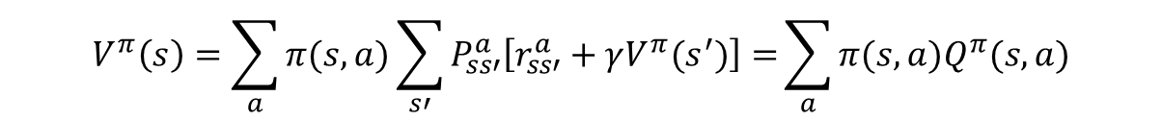
Value functions
state value function: V^{π}(s)
expected return when starting in s and following π
state-action value function: Q^{π}(s,a)
expected return when starting in s, performing a, and following π
useful for finding the optimal policy
s
can estimate from experience
pick the best action using Q^{π}(s,a)
a
r
s’
Bellman equation
$$V^{π}\left(s\right)=\sum_{a}{π(s,a)\sum_{s′}{P_{ss′}^{a}\left[r_{ss′}^{a}+γV^{π}(s^{′})\right]=}\sum_{a}{π(s,a)Q^{π}(s,a)}}$$

Slide 18










Optimal value functions
there’s a set of optimal policies
V^{π} defines partial ordering on policies
they share the same optimal value function
$$V^{∗}\left(s\right)=\max_{π}{V^{π}(s)}$$
Bellman optimality equation
$$V^{∗}\left(s\right)=\max_{a}\sum_{s′}{P_{ss′}^{a}\left[r_{ss′}^{a}+γV^{∗}(s^{′})\right]}$$
s
system of n non-linear equations
solve for V*(s)
easy to extract the optimal policy
a
r
s’
having Q*(s,a) makes it even simpler
$$π^{∗}\left(s\right)=\arg{\max_{a}}Q^{∗}\left(s, a\right)$$

Slide 19
Outline
examples
defining an RL problem
Markov Decision Processes
solving an RL problem
Dynamic Programming
Monte Carlo methods
Temporal-Difference learning

Slide 20


Dynamic programming
main idea
use value functions to structure the search for good policies
need a perfect model of the environment
two main components
policy evaluation: compute V^{π} from π
policy improvement: improve π based on V^{π}
start with an arbitrary policy
repeat evaluation/improvement until convergence

Slide 21

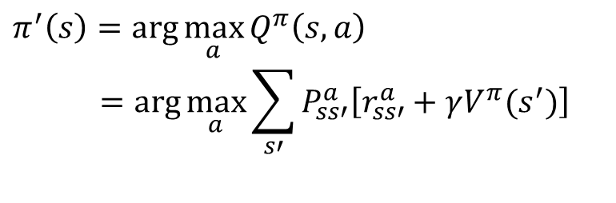
Policy evaluation/improvement
policy evaluation: π -> V^{π}
Bellman eqn’s define a system of n eqn’s
could solve, but will use iterative version
$$V_{k+1}\left(s\right)=\sum_{a}{π(s,a)\sum_{k^{′}}{P_{{ss}^{′}}^{a}\left[r_{{ss}^{′}}^{a}+γV_{k} (s^{′})\right]}}$$
– start with an arbitrary value function V₀, iterate until V_{k} converges
policy improvement: V^{π} -> π’
$$π^{′}\left(s\right)=\arg{\max_{a}}Q^{π}\left(s, a\right)$$
$$=arg{\max_{a}\sum_{s′}{P_{ss′}^{a}\left[r_{ss′}^{a}+γV^{π}(s^{′})\right]}}$$
– π’ either strictly better than π, or π’ is optimal (if π = π’)

Slide 22

Policy/Value iteration
Policy iteration
$$π_{0}→^{E}V^{π_{0}}→^{I}π_{1}→^{E}V^{π_{1}}→^{I}…→^{I}π^{∗}→^{E}V^{∗}$$
two nested iterations; too slow
don’t need to converge to V^{πk}
just move towards it
Value iteration
use Bellman optimality equation as an update
converges to V*
$$V_{k+1}\left(s\right)=\max_{a}\sum_{s^{′}}{P_{{ss}^{′}}^{a}\left[r_{{ss}^{′}}^{a}+γV_{k} (s^{′})\right]}$$

Slide 23
Using DP
need complete model of the environment and rewards
robot in a room
state space, action space, transition model
can we use DP to solve
robot in a room?
back gammon?
helicopter?

Slide 24
Outline
examples
defining an RL problem
Markov Decision Processes
solving an RL problem
Dynamic Programming
Monte Carlo methods
Temporal-Difference learning
miscellaneous
state representation
function approximation
rewards

Slide 25
Monte Carlo methods
don’t need full knowledge of environment
just experience, or
simulated experience
but similar to DP
policy evaluation, policy improvement
averaging sample returns
defined only for episodic tasks

Slide 26










Monte Carlo policy evaluation
want to estimate V^{π}(s)
= expected return starting from s and following π
estimate as average of observed returns in state s
first-visit MC
average returns following the first visit to state s
s s
+1 -2
s₀
R₁(s) = +2
0
+1
-3
+5
s₀ s₀ s₀ s₀ s₀
R₂(s) = +1
R₃(s) = -5
R₄(s) = +4
V^{π}(s) ≈ (2 + 1 – 5 + 4)/4 = 0.5

Slide 27


Monte Carlo control
V^{π} not enough for policy improvement
need exact model of environment
estimate Q^{π}(s,a)
MC control
update after each episode
non-stationary environment
a problem
greedy policy won’t explore all actions
$$π^{′}\left(s\right)=arg\max_{a}{Q^{π}(s, a)}$$
$$π_{0}→^{E}Q^{π_{0}}→^{I}π_{1}→^{E}Q^{π_{1}}→^{I}…→^{I}π^{∗}→^{E}Q^{∗}$$
$$V\left(s\right)←V\left(s\right)+α\left[R−V(s)\right]$$

Slide 28
Maintaining exploration
deterministic/greedy policy won’t explore all actions
don’t know anything about the environment at the beginning
need to try all actions to find the optimal one
maintain exploration
use soft policies instead: π(s,a)>0 (for all s,a)
ε-greedy policy
with probability 1-ε perform the optimal/greedy action
with probability ε perform a random action
will keep exploring the environment
slowly move it towards greedy policy: ε -> 0

Slide 29
Simulated experience
5-card draw poker
– s₀: A♣, A♦, 6♠, A♥, 2♠
a₀: discard 6♠, 2♠
s₁: A♣, A♦, A♥, A♠, 9♠ + dealer takes 4 cards
return: +1 (probably)
DP
list all states, actions, compute P(s,a,s’)
P( [A♣,A♦,6♠,A♥,2♠], [6♠,2♠], [A♠,9♠,4] ) = 0.00192
MC
all you need are sample episodes
let MC play against a random policy, or itself, or another algorithm

Slide 30
Summary of Monte Carlo
don’t need model of environment
averaging of sample returns
only for episodic tasks
learn from sample episodes or simulated experience
can concentrate on “important” states
don’t need a full sweep
need to maintain exploration
use soft policies

Slide 31
Outline
examples
defining an RL problem
Markov Decision Processes
solving an RL problem
Dynamic Programming
Monte Carlo methods
Temporal-Difference learning
miscellaneous
state representation
function approximation
rewards

Slide 32

Temporal Difference Learning
combines ideas from MC and DP
like MC: learn directly from experience (don’t need a model)
like DP: learn from values of successors
works for continuous tasks, usually faster than MC
constant-alpha MC:
have to wait until the end of episode to update
target
simplest TD
update after every step, based on the successor
$$V\left(s_{t}\right)←V\left(s_{t}\right)+α\left[R_{t}−V\left(s_{t}\right)\right]$$
$$V\left(s_{t}\right)←V\left(s_{t}\right)+α\left[r_{t+1}+γV(s_{t+1})−V\left(s_{t}\right)\right]$$

Slide 33
MC vs. TD
observed the following 8 episodes:
A – 0, B – 0 | B – 1 | B – 1 | B - 1
B – 1 | B – 1 | B – 1 | B – 0
MC and TD agree on V(B) = 3/4
MC: V(A) = 0
– converges to values that minimize the error on training data
r = 1
75%
TD: V(A) = 3/4
– converges to ML estimate of the Markov process
r = 0
100%
B
r = 0
25%
A

Slide 34
Sarsa
again, need Q(s,a), not just V(s)
s_{t}
a_{t}
^{s}t+1
r_{t}
ªt+1
^{s}t+2
^{r}t+1
ªt+2
$$Q\left(s_{t},a_{t}\right)←Q\left(s_{t},a_{t}\right)+α\left[r_{t}+γQ(s_{t+1},a_{t+1})−Q\left(s_{t},a_{t}\right)\right]$$
control
start with a random policy
update Q and π after each step
again, need ε-soft policies

Slide 35
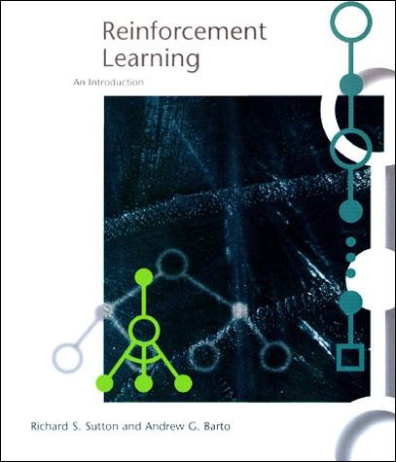
The RL Intro book
Richard Sutton, Andrew Barto Reinforcement Learning,
An Introduction
http://www.cs.ualberta.ca/
~sutton/book/the-book.html

Slide 36
Q-learning
before: on-policy algorithms
start with a random policy, iteratively improve
converge to optimal
Q-learning: off-policy
use any policy to estimate Q
Q directly approximates Q* (Bellman optimality eqn)
independent of the policy being followed
only requirement: keep updating each (s,a) pair
Sarsa
$$Q\left(s_{t},a_{t}\right)←Q\left(s_{t},a_{t}\right)+α\left[r_{t+1}+γ\max_{a} Q(s_{t+1},a)−Q\left(s_{t},a_{t}\right)\right]$$
$$Q\left(s_{t},a_{t}\right)←Q\left(s_{t},a_{t}\right)+α\left[r_{t}+γQ(s_{t+1},a_{t+1})−Q\left(s_{t},a_{t}\right)\right]$$

Slide 37
Outline
examples
defining an RL problem
Markov Decision Processes
solving an RL problem
Dynamic Programming
Monte Carlo methods
Temporal-Difference learning
miscellaneous
state representation
function approximation
rewards

Slide 38
State representation
pole-balancing
move car left/right to keep the pole balanced
state representation
position and velocity of car
angle and angular velocity of pole
what about Markov property?
would need more info
noise in sensors, temperature, bending of pole
solution
coarse discretization of 4 state variables
left, center, right
totally non-Markov, but still works

Slide 39

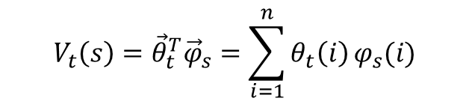
Function approximation
represent V_{t} as a parameterized function
linear regression, decision tree, neural net, …
linear regression:
update parameters instead of entries in a table
better generalization
fewer parameters and updates affect “similar” states as well
TD update
$$V_{t}\left(s\right)={\vec{θ}}_{t}^{T}{\vec{φ}}_{s}=\sum_{i=1}^{n}{θ_{t}\left(i\right)}φ_{s}(i)$$
$$V\left(s_{t}\right)←V\left(s_{t}\right)+α\left[r_{t+1}+γV(s_{t+1})−V\left(s_{t}\right)\right]$$
$$V\left(s_{t}\right)⟼r_{t+1}+γV(s_{t+1})$$
x y
treat as one data point for regression
want method that can learn on-line (update after each step)

Slide 40
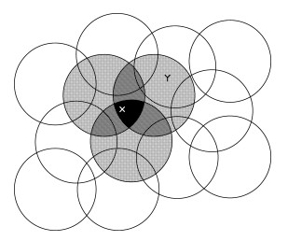
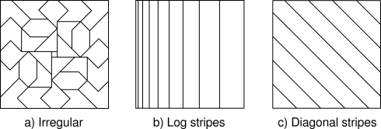
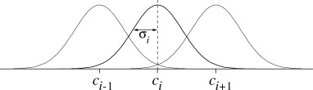
Features
tile coding, coarse coding
– binary features
radial basis functions
typically a Gaussian
between 0 and 1
[ Sutton & Barto, Reinforcement Learning ]

Slide 41
Splitting and aggregation
want to discretize the state space
learn the best discretization during training
splitting of state space
start with a single state
split a state when different parts of that state have different values
state aggregation
start with many states
merge states with similar values

Slide 42
Designing rewards
robot in a maze
episodic task, not discounted, +1 when out, 0 for each step
chess
GOOD: +1 for winning, -1 losing
BAD: +0.25 for taking opponent’s pieces
high reward even when lose
rewards
rewards indicate what we want to accomplish
NOT how we want to accomplish it
shaping
positive reward often very “far away”
rewards for achieving subgoals (domain knowledge)
also: adjust initial policy or initial value function

Slide 43
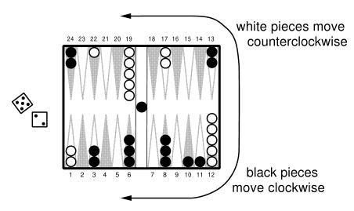
Case study: Back gammon
rules
30 pieces, 24 locations
roll 2, 5: move 2, 5
hitting, blocking
branching factor: 400
implementation
use TD(λ) and neural nets
4 binary features for each position on board (# white pieces)
no BG expert knowledge
results
TD-Gammon 0.0: trained against itself (300,000 games)
as good as best previous BG computer program (also by Tesauro)
lot of expert input, hand-crafted features
TD-Gammon 1.0: add special features
TD-Gammon 2 and 3 (2-ply and 3-ply search)
1.5M games, beat human champion

Slide 44
Summary
Reinforcement learning
use when need to make decisions in uncertain environment
solution methods
dynamic programming
need complete model
Monte Carlo
time-difference learning (Sarsa, Q-learning)
most work
algorithms simple
need to design features, state representation, rewards

Slide 45
Thank You

